Slide 1
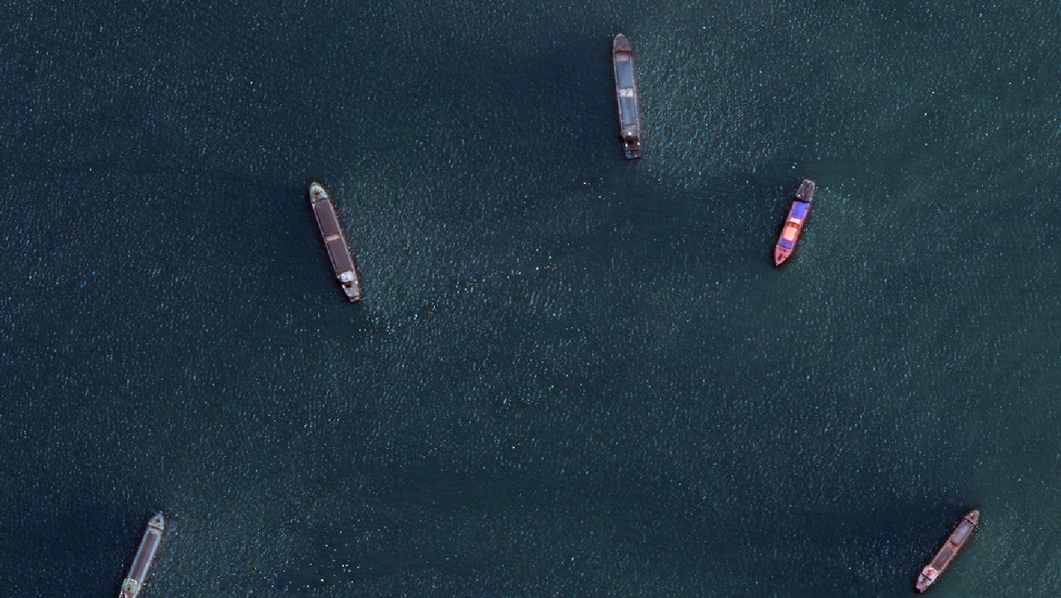
Ship Detection
Deep Learning 2021 | Beeler Martin, Felder Thomas, Rehmann Christoph

Slide 2
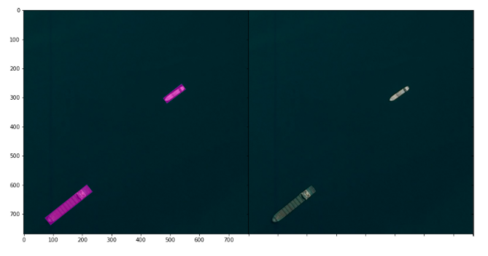
Background
Introduction Dataset Model I Model II Model III Model IV Conclusion
Shipping traffic is growing.
More ships increase the chances of infractions at sea like environmentally devastating ship accidents, piracy, illegal fishing, drug trafficking etc.
For this reason, Airbus launched a Kaggle-Challenge in 2018 for building a model that detects all ships in satellite images ($ 60’000 prize money).
Primary goal is to increase the accuracy and speed of automatic ship detection.
Locate ships in images.
Put an aligned bounding box around the ships.

Slide 3
Goals
Introduction Dataset Model I Model II Model III Model IV Conclusion
Get to know the dataset.
Apply theoretical knowledge in practice.
Build several models:
binary detection → is one or more ships on the image?
multinomial classification → count the number of ships in an image
regression model with TFP & Gaussian CPD (flexible mean & variance)
→ count the number of ships in an image
image segmentation with bounding box/masks → “Kaggle challenge”

Slide 4

Dataset
Introduction Dataset Model I Model II Model III Model IV Conclusion
size: ca. 28 GB
192’556 coloured Images
format: *.JPG
resolution: 768 x 768 pixels
various conditions: sunny, clouds, haze
Name = ImageID
satellite images
(Source: VectorStock, 2020)

Slide 5

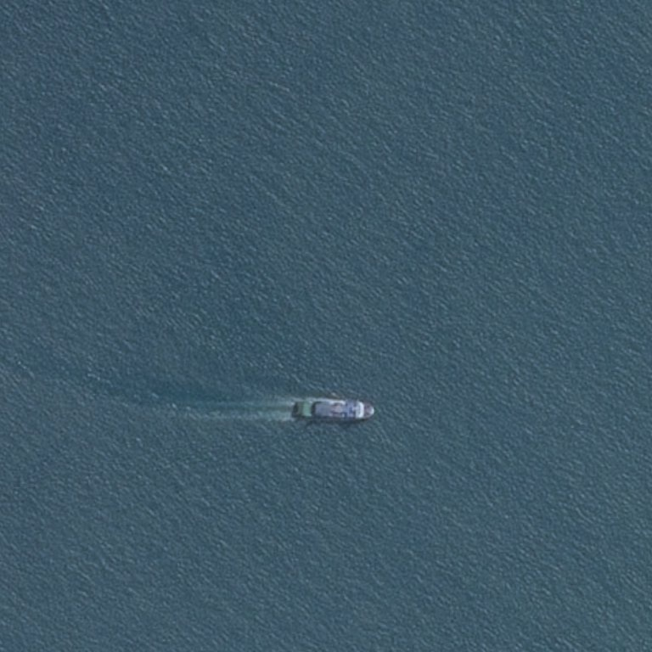
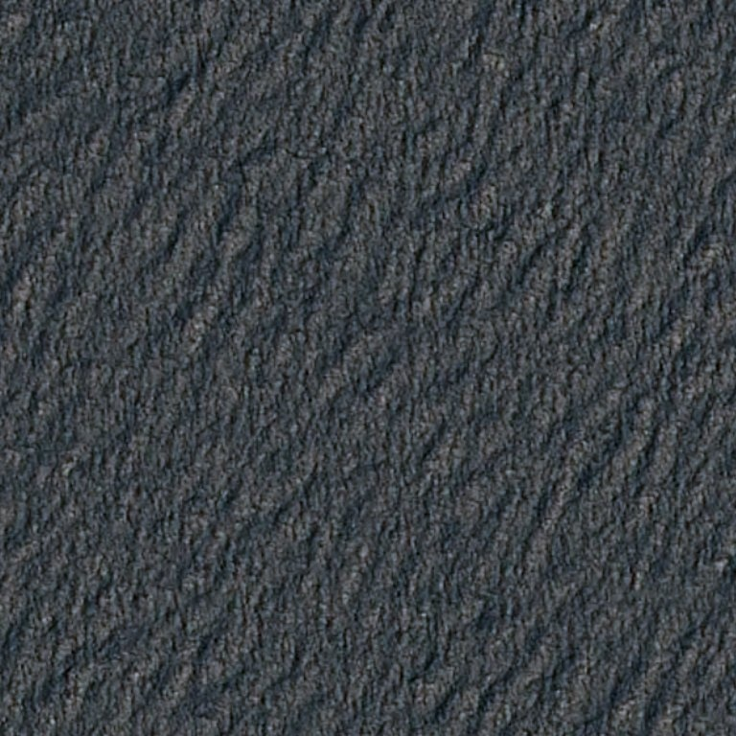
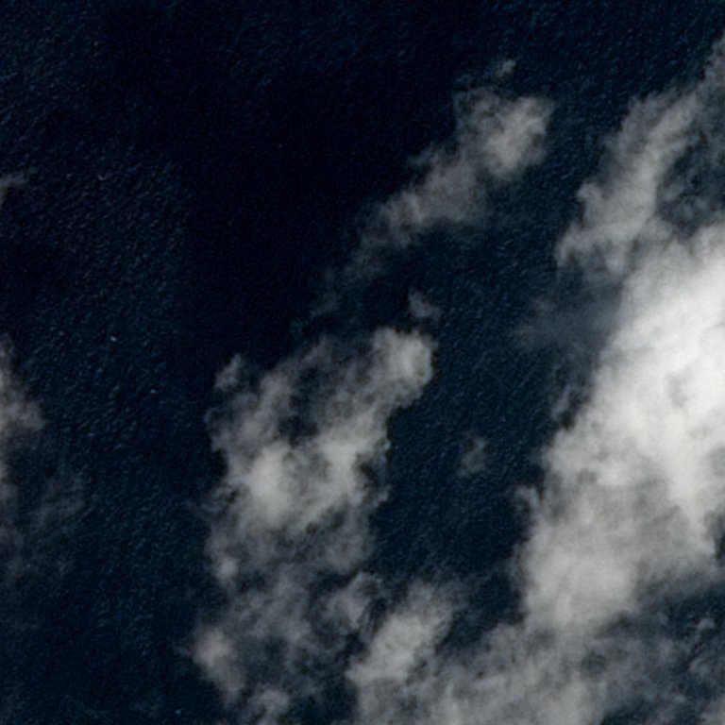
Some Examples …

Slide 6
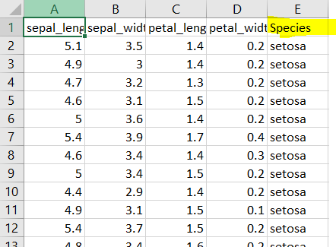
Dataset
Introduction Dataset Model I Model II Model III Model IV Conclusion
size: ca. 44 MB
234’724 (rows) x 2 (columns)
format: *.CSV
row: every ship in an image
columns:
ImageID:
name, refer to image
EncodedPixels:
1. value: start ship (pixel coordinates)
2. value: end ship (number of pixels)
labelled data
(Sources: Quora, 2020)

Slide 7
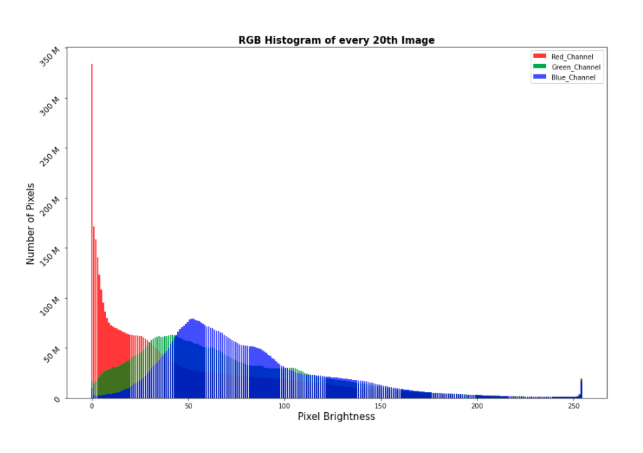
Explorative Data Analysis
Introduction Dataset Model I Model II Model III Model IV Conclusion
ca. 10’000 images
images are rather dark
values of Red_Channel are “lost”
blue and green tones are dominant

Slide 8
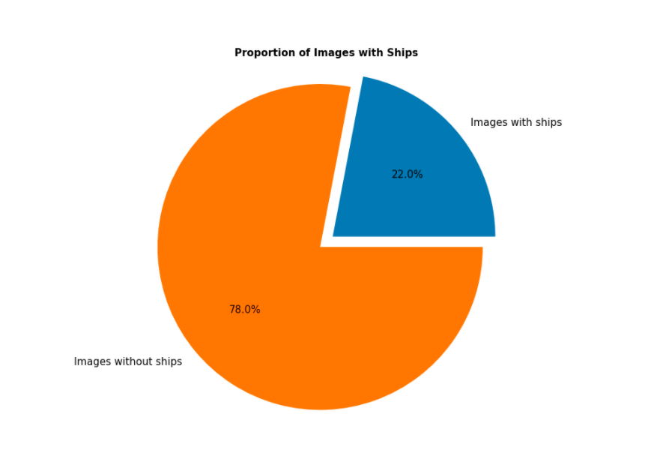
Explorative Data Analysis
Introduction Dataset Model I Model II Model III Model IV Conclusion
42’556 images
150’000 images

Slide 9
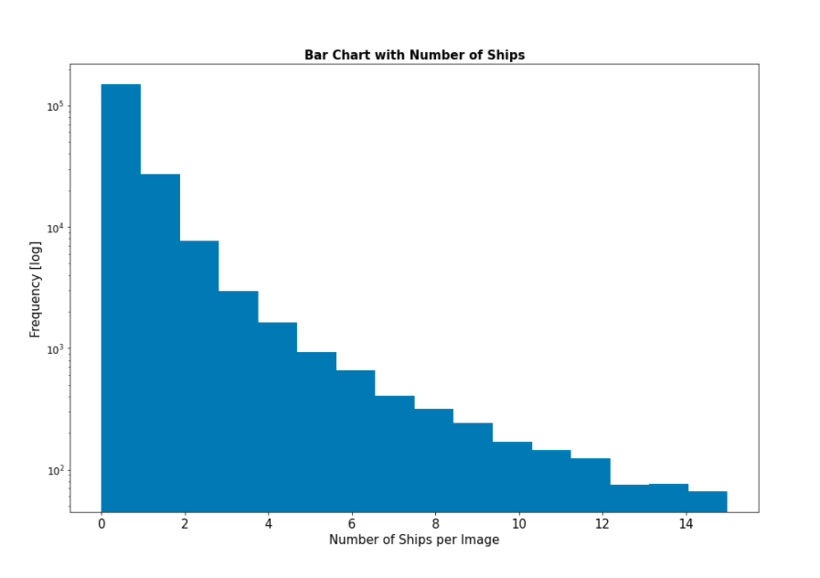
Explorative Data Analysis
Introduction Dataset Model I Model II Model III Model IV Conclusion
right skewed distribution
minimum number of ships: 0
maximum number of ships: 15

Slide 10
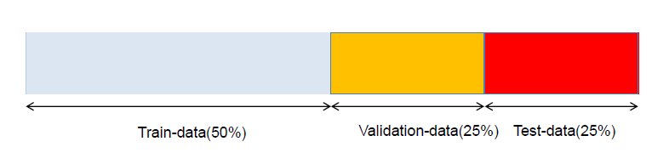
Preparation
Introduction Dataset Model I Model II Model III Model IV Conclusion
Split data in training-, validation-, test-data with …
data generator
Define & append 2 new variables:
“HasShips”
“NumberOfShips”
Source: Sick et. al. (2021)

Slide 11

Simple Ship Detection
Introduction Dataset Model I Model II Model III Model IV Conclusion
GOAL: Detect whether there is a ship in the image or not.
binary classification
NN with Convolutional Neural Network (cNN)
2 classes
loss function = categorical cross entropy $D\left(\hat{y},y\right)=−\sum_{i=1}^{2}{[y_{i}∗\log{\hat{y}}]}$

Slide 12
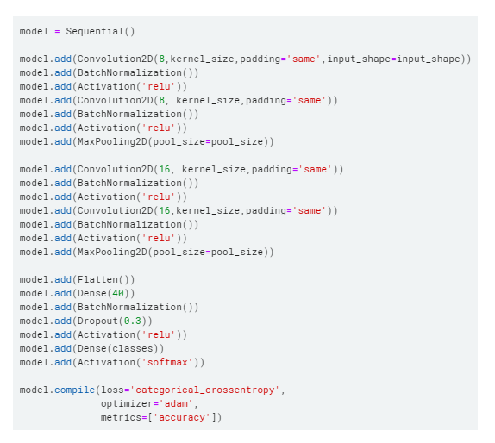
Simple Ship Detection - Model
Introduction Dataset Model I Model II Model III Model IV Conclusion
4 convolutional blocks
2 with 8 filters each
2 with 16 filters each
batch normalization between convolutional layers
fcNN layer with 40 nodes + dropout
activation: ReLU, Softmax
loss: categorical cross entropy

Slide 13
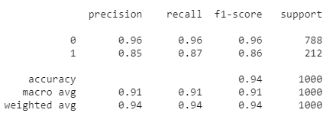
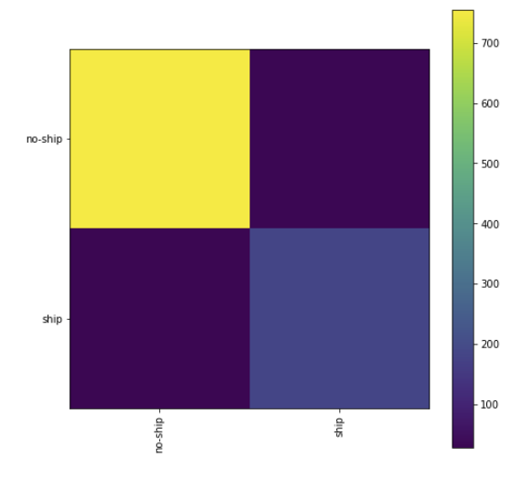
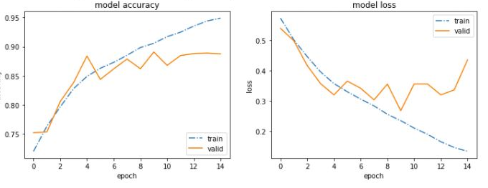
Simple Ship Detection - Results
Introduction Dataset Model I Model II Model III Model IV Conclusion

Slide 14
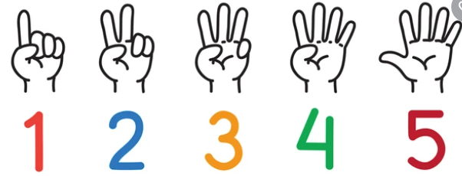

Multinomial Classification
Introduction Dataset Model I Model II Model III Model IV Conclusion
GOAL: Count the number of ships in an image.
multinomial classification
NN with Convolutional Neural Network (cNN)
4 or 6 classes
loss function = categorical cross entropy $D\left(\hat{y},y\right)=−\sum_{i=1}^{N}{[y_{i}∗\log{\hat{y}}]}$

Slide 15
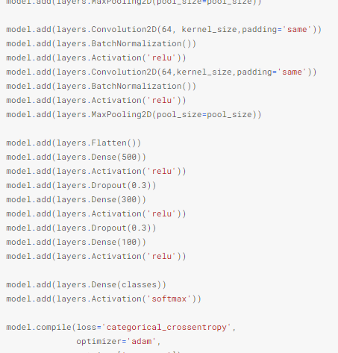
Multinomial Classification - Model
Introduction Dataset Model I Model II Model III Model IV Conclusion
6 convolutional blocks
2 with 8 filters each
2 with 16 filters each
2 with 64 filters each
batch normalization between convolutional layers
3 fcNN layer with 500, 300, 100 nodes + dropout
activation: ReLU, Softmax
loss: categorical cross entropy

Slide 16
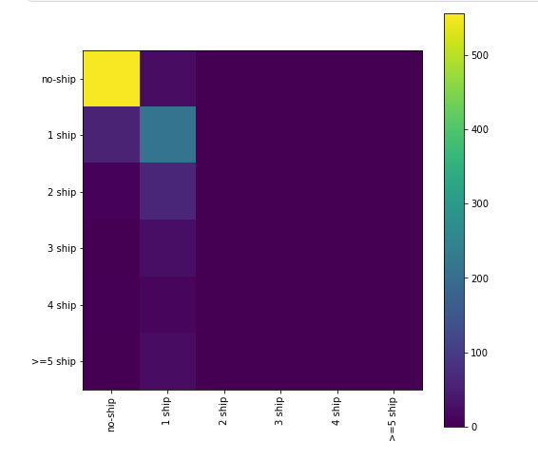
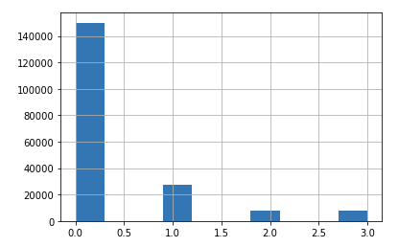

Multinomial Classification - Results
Introduction Dataset Model I Model II Model III Model IV Conclusion
6 classes – multinomial ...
6 Klassen - Multinomial
4 classes - balanced …
… with sample size 10'000
… model classifies > 1 ship wrong

Slide 17
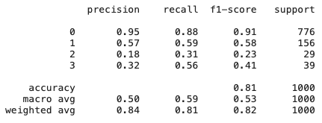
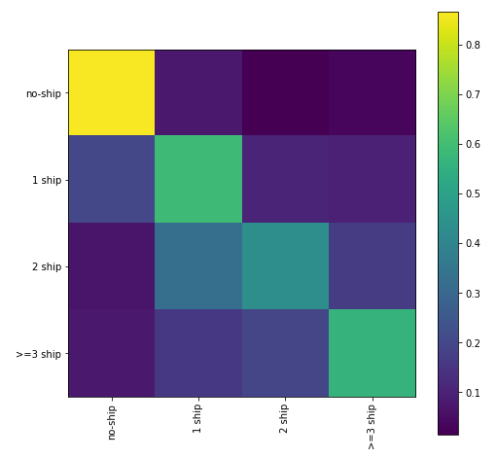
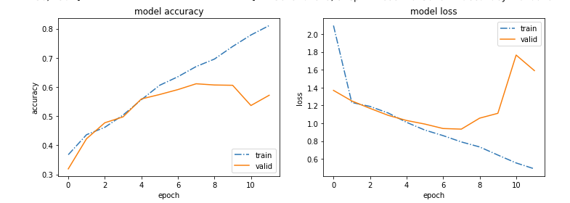
Multinomial Classification - Results
Introduction Dataset Model I Model II Model III Model IV Conclusion

Slide 18
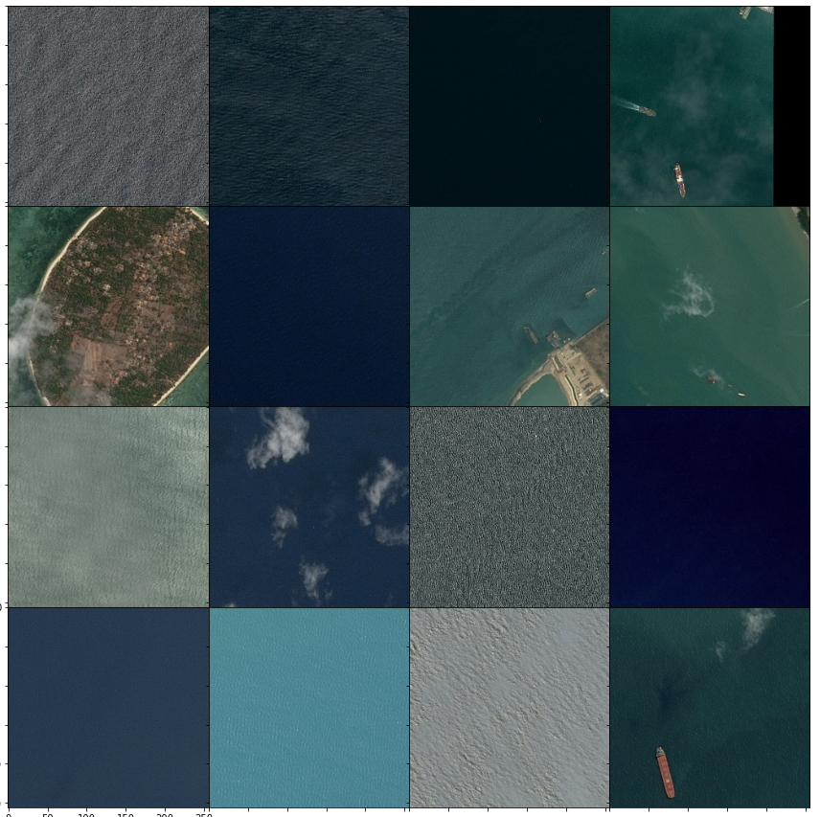
Multinomial Classification - Results
Introduction Dataset Model I Model II Model III Model IV Conclusion
0 1 2 >= 3
<1% 35% 42% 22%
0 1 2 >= 3
93% 6% 0.5% 0.5%
0 1 2 >= 3
1.5% 5.8% 0.7% 92%
0 1 2 >= 3
<1% 28% 53% 18%
0 1 2 >= 3 98% 1.5% < 1% < 1%
0 1 2 >= 3
<1% 68% 31% <1%

Slide 19
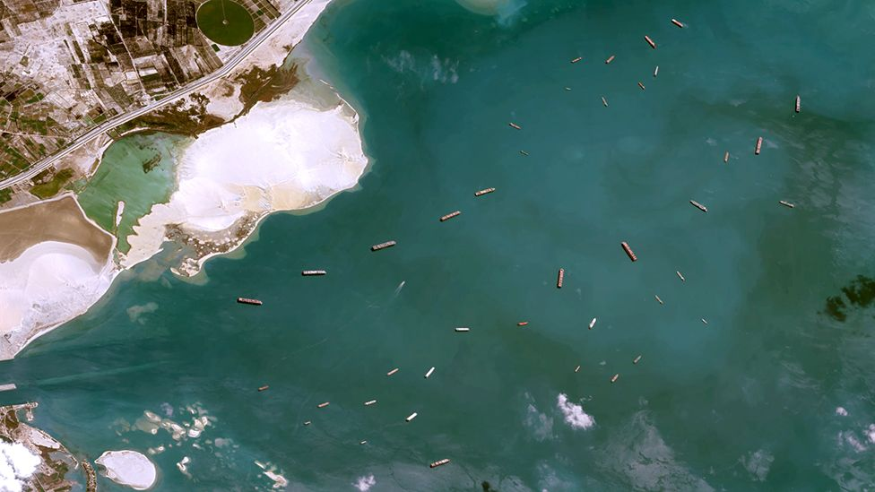
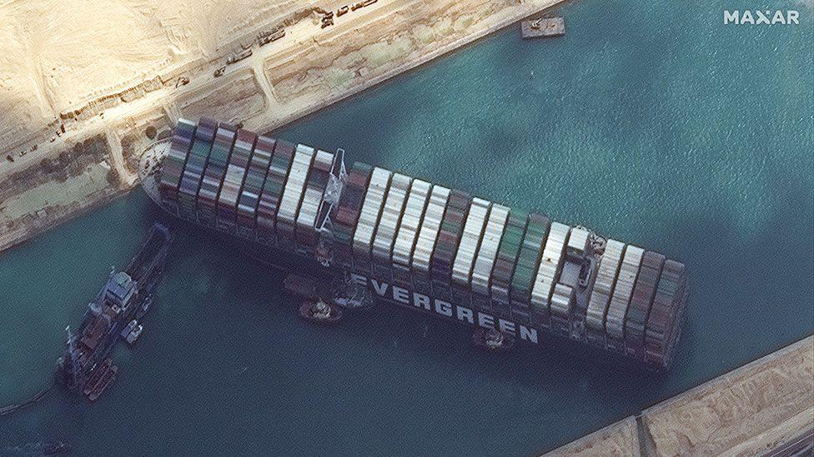
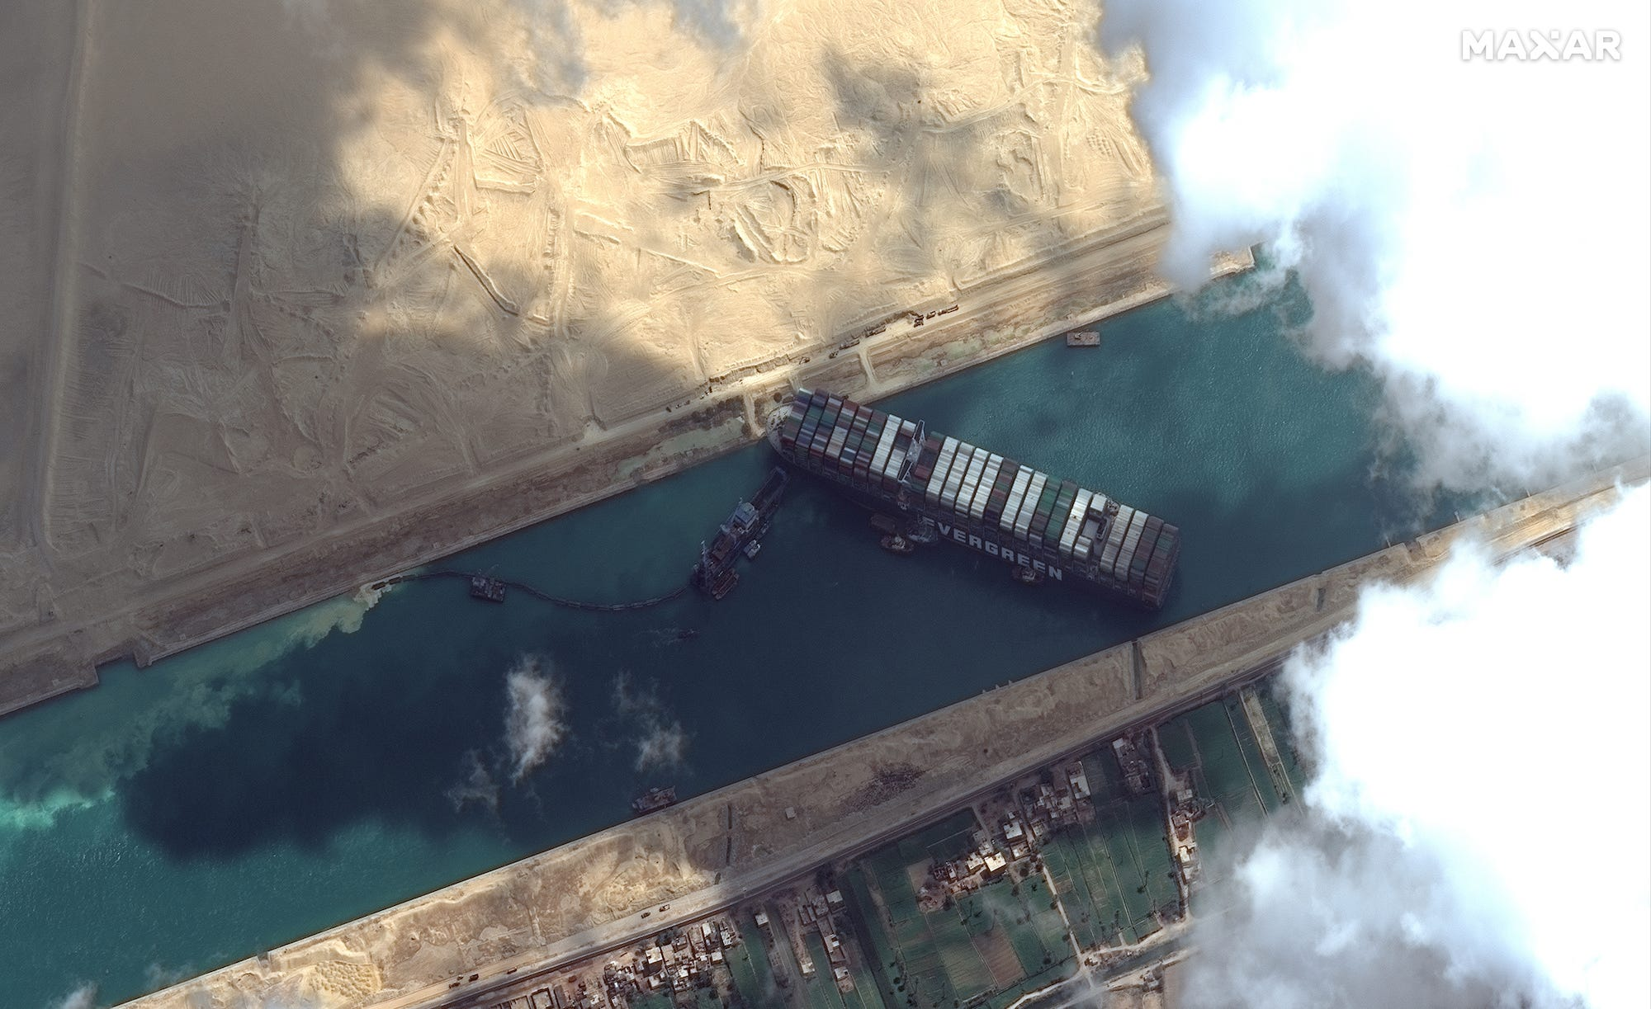
Multinomial Classification - Results
Introduction Dataset Model I Model II Model III Model IV Conclusion
Elephant in the Suez Canal
No ship >= 3
47% 36%
>= 3 Ships 98%
No ship 1 Ship
< 1 % 92%

Slide 20

Regression with TFP & Gauss
Introduction Dataset Model I Model II Model III Model IV Conclusion
GOAL: Count the number of ships in an image (at least one ship!)
Regression Model, Gaussian CPD with flexible mean & variance
NN with Convolutional Neural Network (cNN)
loss function = negative log-likelihood (NLL) $w_{ML}=\underset{w}{argmin}{\sum_{i=1}^{n}{−log⁡(\frac{1}{\sqrt{2πσ^{2}}})+\frac{{(y_{i}−μ_{x_{i}})}^{2}}{2σ^{2}}}}$

Slide 21
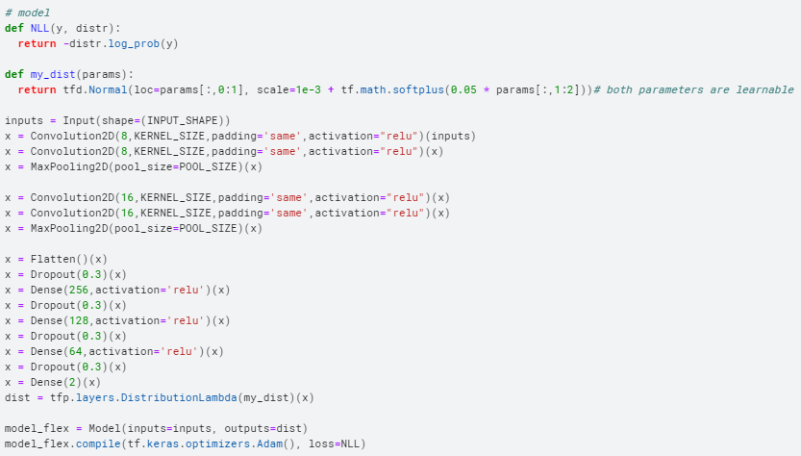
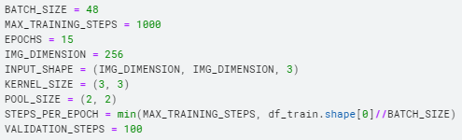
Regression with TFP & Gauss - Model
Introduction Dataset Model I Model II Model III Model IV Conclusion
4 convolutional blocks
2 with 8 filters each
2 with 16 filters each
3 fcNN layer with 256, 128, 64 nodes + dropout
activation: ReLU
loss: negative log-likelihood (NLL)

Slide 22
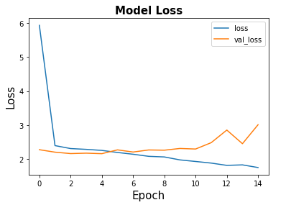

Regression with TFP & Gauss - Results
Introduction Dataset Model I Model II Model III Model IV Conclusion
loss plot seems ok
no overfitting

Slide 23
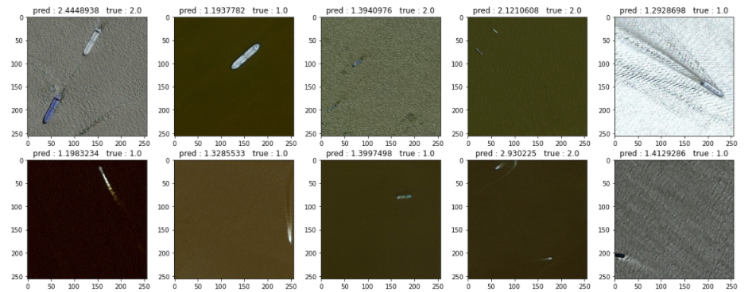
Regression with TFP & Gauss - Results
Introduction Dataset Model I Model II Model III Model IV Conclusion
predicted mean of the CPD on test set

Slide 24
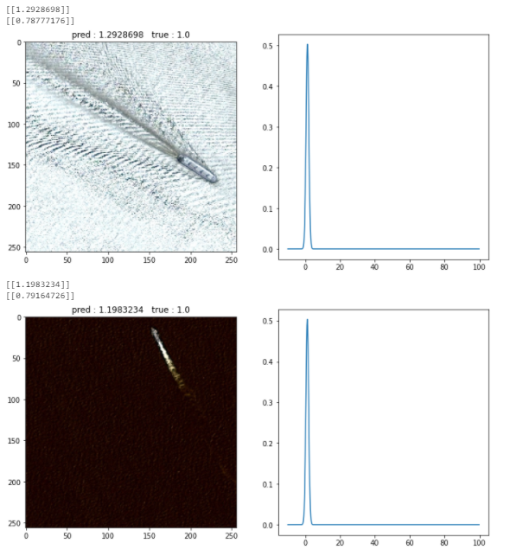
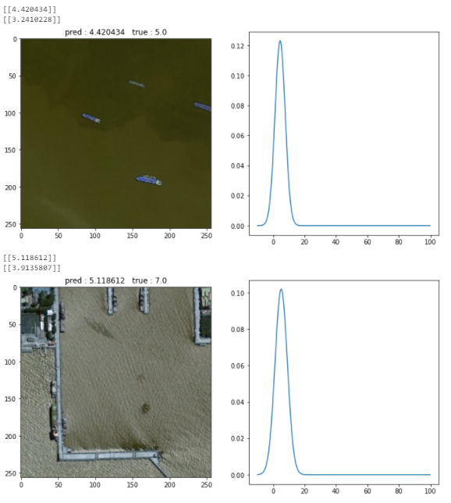
Regression with TFP & Gauss - Results
Introduction Dataset Model I Model II Model III Model IV Conclusion
predicted mean & sigma of the CPD on test set
analysis:
more precise prediction for images with one ship
higher uncertainty for images with more ships
open works:
→ do another model fit with constant variance
→ data augmentation to achieve more “normal distribution”

Slide 25
Image Segmentation - Model
Introduction Dataset Model I Model II Model III Model IV Conclusion
U-Net Architecture (cnn that was developed for biomedical image segmentation)
Predict image mask (bounding box) (256x256x1 output)
Loss-Function: Intersection over Union

Slide 26
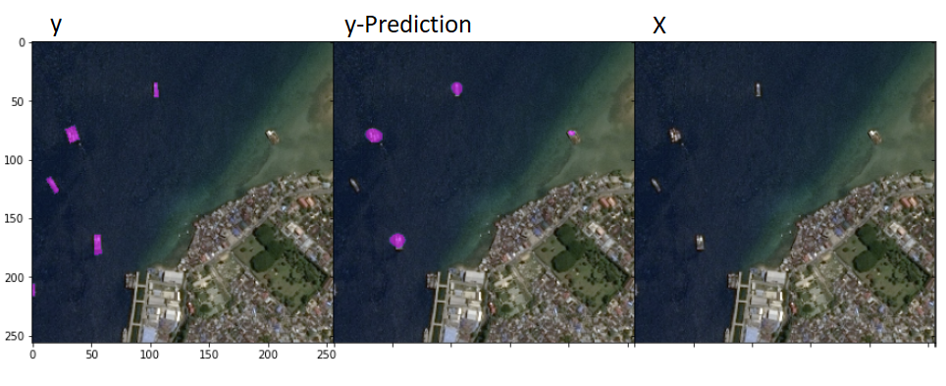
Image Segmentation - Results
Introduction Dataset Model I Model II Model III Model IV Conclusion
Jaccard coefficient: 0.21 (with binary ensemble 0.25)
FBeta-Score: 0.30 (with binary ensemble 0.32)
Examples:

Slide 27
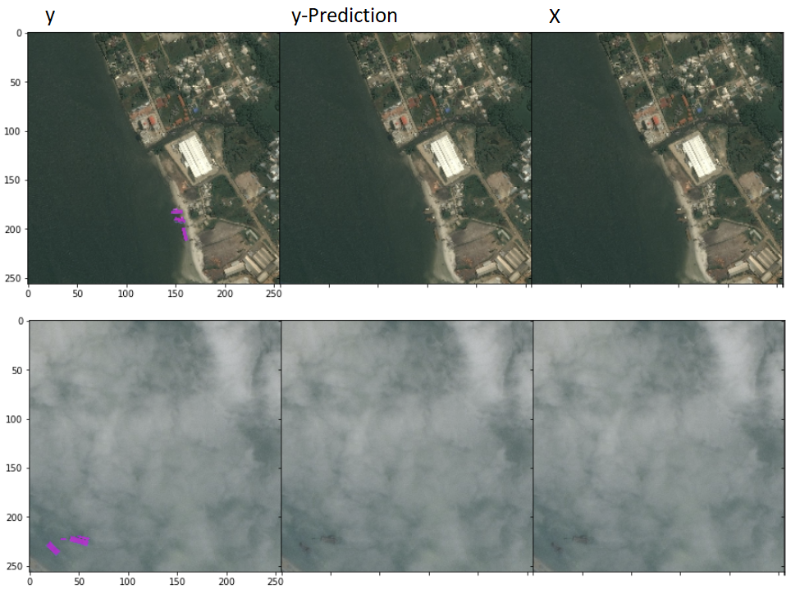
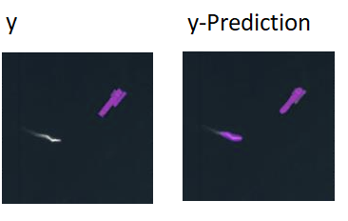
Image Segmentation - Results
Introduction Dataset Model I Model II Model III Model IV Conclusion

Slide 28
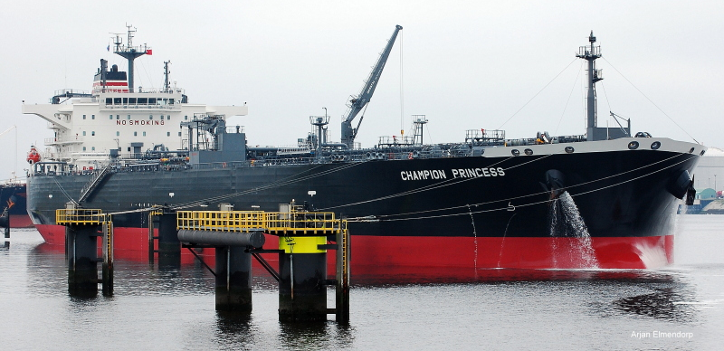
Prospect
Introduction Dataset Model I Model II Model III Model IV Conclusion
Clean Data Set
Data Augmentation
Last but not least:
→ improve model further
and win on Kaggle

Slide 29
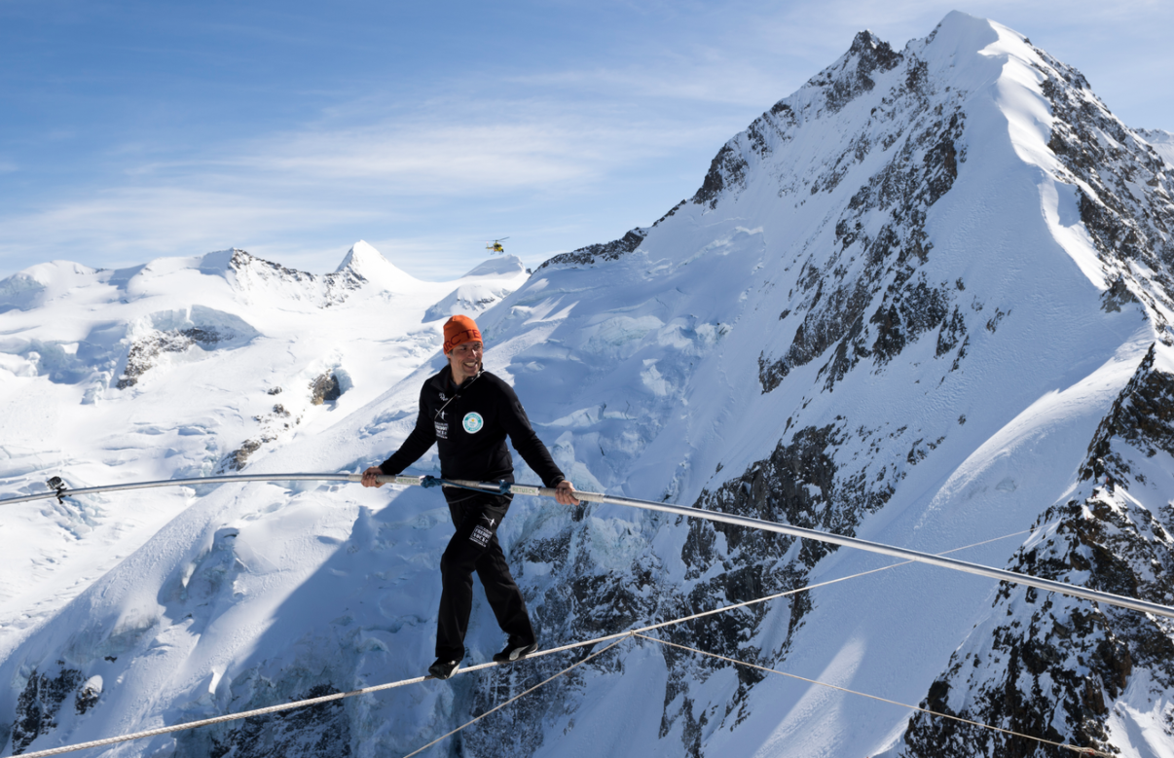
Learnings & Conclusions
Introduction Dataset Model I Model II Model III Model IV Conclusion
Finding balance is key
accuracy vs. velocity (high resolution vs. RAM)
training vs. test dataset
balance classes
complex vs. simple model
Train a model takes some time …
→ Think first – then start!

Slide 30
Sources
https://medium.com/earthcube-stories/how-hard-it-is-for-an-ai-to-detect-ships-on-satellite-images-7265e34aadf0
https://www.kaggle.com/c/airbus-ship-detection/overview
https://www.quora.com/What-is-labeled-data
https://www.vectorstock.com/royalty-free-vector/layers-or-stack-papers-icon-outline-modern-vector-20588695

